Slide 1
Timing with Optimization
Theorem: A sequence of m union and find operations, n of which are find operations, can be performed on a disjoint-set forest with union by rank (weight or height) and path compression in worst case time proportional to (m (n)).
(n) is the inverse Ackermann’s function which grows extremely slowly. For all practical puposes, (n)  4.
Union-find is essentially proportional to m for a sequence of m operations, linear in m.
Notes:
End of lecture 36

Slide 2
Lecture No.37
Data Structures
Dr. Sohail Aslam

Slide 3
Image Segmentation
Inclusion criteria for pixels
  use pixel intensity,
  threshold of intensity,
  threshold for difference in intensity of neighbors,
  texture (ie. a pattern of pixel intensities)
Notes:
Start lecture 37 here.

Slide 4
Image Segmentation
0 1 2 3 4
0 0 0 0 4 4
1 2 0 4 4 0
2 4 2 2 4 4
3 4 4 0 4 4
4 0 2 2 4 0

Slide 5
Image Segmentation
0 1 2 3 4
0 0 0 0 4 4
1 2 0 4 4 0
2 4 2 2 4 4
3 4 4 0 4 4
4 0 2 2 4 0
0 1 2 3 4
0 0 0 0 1 1
1 0 0 1 1 0
2 1 0 0 1 1
3 1 1 0 1 1
4 0 0 0 1 0
Threshold=4

Slide 6
Image Segmentation
0 1 2 3 4
0 0 0 0 4 4
1 2 0 4 4 0
2 4 2 2 4 4
3 4 4 0 4 4
4 0 2 2 4 0
0 1 2 3 4
0 0 0 0 1 1
1 1 0 1 1 0
2 1 1 1 1 1
3 1 1 0 1 1
4 0 1 1 1 0
Threshold=2

Slide 7
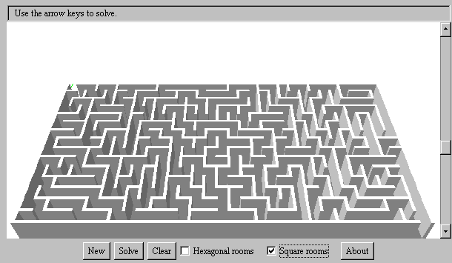
Maze Generation

Slide 8
Maze Generation
A random maze generator can use union-find. Consider a 5x5 maze:
0
1
2
3
4
5
6
7
8
9
10
11
12
13
14
15
16
17
18
19
20
21
22
23
24

Slide 9
Maze Generator
Initially, 25 cells, each isolated by walls from the others.
This corresponds to an equivalence relation -- two cells are equivalent if they can be reached from each other (walls been removed so there is a path from one to the other).

Slide 10
Maze Generator
To start, choose an entrance and an exit.
IN
➔
0
1
2
3
4
5
6
7
8
9
10
11
12
13
14
15
16
17
18
19
20
21
22
23
24
➔
OUT

Slide 11
Maze Generator
Randomly remove walls until the entrance and exit cells are in the same set.
Removing a wall is the same as doing a union operation.
Do not remove a randomly chosen wall if the cells it separates are already in the same set.

Slide 12
MakeMaze
MakeMaze(int size) {
entrance = 0; exit = size-1;
while (find(entrance) != find(exit)) {
cell1 = randomly chosen cell
cell2 = randomly chosen adjacent cell
if (find(cell1) != find(cell2) {
knock down wall between cells
union(cell1, cell2)
}
}

Slide 13
Maze Generator
Cell 11, right wall chosen randomly
IN
➔
0
1
2
3
4
5
6
7
8
9
10
11
12
13
14
15
16
17
18
19
20
21
22
23
24
➔
OUT

Slide 14
Maze Generator
Cell 11, right wall chosen randomly
IN
➔
0
1
2
3
4
5
6
7
8
9
S_11 = { 11,12}
10
11
12
13
14
15
16
17
18
19
20
21
22
23
24
➔
OUT

Slide 15
Maze Generator
Cell 6, bottom wall chosen randomly
IN
➔
0
1
2
3
4
5
6
7
8
9
S_11 = { 11,12}
10
11
12
13
14
15
16
17
18
19
20
21
22
23
24
➔
OUT

Slide 16
Maze Generator
Cell 6, bottom wall chosen randomly
IN
➔
0
1
2
3
4
5
6
7
8
9
S_11 = { 11,12, 6}
10
11
12
13
14
15
16
17
18
19
20
21
22
23
24
➔
OUT

Slide 17
Maze Generator
Cell 8, top wall chosen randomly
IN
➔
0
1
2
3
4
5
6
7
8
9
S_11 = { 11,12, 6}
10
11
12
13
14
15
16
17
18
19
20
21
22
23
24
➔
OUT

Slide 18
Maze Generator
Cell 8, top wall chosen randomly
IN
➔
0
1
2
3
4
5
6
7
8
9
S_11 = { 11,12, 6}
S_8 = { 8,3}
10
11
12
13
14
15
16
17
18
19
20
21
22
23
24
➔
OUT

Slide 19
Maze Generator
Cell 14, top wall chosen randomly
IN
➔
0
1
2
3
4
5
6
7
8
9
S_11 = { 11,12, 6}
S_8 = { 8,3}
10
11
12
13
14
15
16
17
18
19
20
21
22
23
24
➔
OUT

Slide 20
Maze Generator
Cell 14, top wall chosen randomly
IN
➔
0
1
2
3
4
5
6
7
8
9
S_11 = { 11,12, 6}
S_8 = { 8,3}
10
11
12
13
14
S_14 = { 14,9}
15
16
17
18
19
20
21
22
23
24
➔
OUT

Slide 21
Maze Generator
Cell 0, bottom wall chosen randomly
IN
➔
0
1
2
3
4
5
6
7
8
9
S_11 = { 11,12, 6}
S_8 = { 8,3}
10
11
12
13
14
S_14 = { 14,9}
15
16
17
18
19
20
21
22
23
24
➔
OUT

Slide 22
Maze Generator
Cell 0, bottom wall chosen randomly
IN
➔
0
1
2
3
4
5
6
7
8
9
S_11 = { 11,12, 6}
S_8 = { 8,3}
10
11
12
13
14
S_14 = { 14,9}
15
16
17
18
19
S_0 = { 0,5}
20
21
22
23
24
➔
OUT
Notes:
End of lecture 37.

